Slide 1
An introduction to MapReduce
Dimitris Chatzopoulos

Slide 2



Input: a big dataset
Output: information
ID | Age | Gender | Region | Vaccination Status
0 | 75 | M | R1 | √
1 | 22 | F | R1 | X
2 | 82 | M | R1 | √
3 | 30 | F | R1 | X
4 | 50 | M | R2 | √
5 | 19 | M | R2 | X
6 | 60 | M | R2 | √
7 | 20 | F | R2 | X
8 | 61 | F | R3 | √
9 | 21 | F | R3 | X
10 | 62 | F | R3 | √
11 | 63 | M | R4 | √
12 | 20 | M | R4 | X
13 | 64 | F | R4 | √
14 | 21 | F | R4 | X
15 | 65 | M | R4 | √
16 | 25 | F | R4 | X
17 | 67 | M | R4 | √
18 | 27 | M | R4 | X
19 | 28 | F | R4 | X
20 | 40 | F | R4 | √
21 | 41 | F | R4 | √
22 | 70 | M | R4 | √
23 | 29 | F | R4 | X
24 | 77 | M | R5 | √
25 | 22 | M | R5 | X
26 | 83 | M | R5 | √
27 | 82 | F | R5 | √
28 | 81 | F | R5 | √
29 | 80 | M | R5 | √
e.g., vaccination percentage
e.g., average age of vaccinated people
ID | Age | Gender | Region | Vaccination Status
0 | 75 | M | R1 | √
1 | 22 | F | R1 | X
2 | 82 | M | R1 | √
3 | 30 | F | R1 | X
4 | 50 | M | R2 | √
5 | 19 | M | R2 | X
6 | 60 | M | R2 | √
7 | 20 | F | R2 | X
8 | 61 | F | R3 | √
9 | 21 | F | R3 | X
10 | 62 | F | R3 | √
11 | 63 | M | R4 | √
12 | 20 | M | R4 | X
13 | 64 | F | R4 | √
14 | 21 | F | R4 | X
15 | 65 | M | R4 | √
16 | 25 | F | R4 | X
17 | 67 | M | R4 | √
18 | 27 | M | R4 | X
19 | 28 | F | R4 | X
20 | 40 | F | R4 | √
21 | 41 | F | R4 | √
22 | 70 | M | R4 | √
23 | 29 | F | R4 | X
24 | 77 | M | R5 | √
25 | 22 | M | R5 | X
26 | 83 | M | R5 | √
27 | 82 | F | R5 | √
28 | 81 | F | R5 | √
29 | 80 | M | R5 | √
MapReduce
Framework
60% of the
population is vaccinated
MapReduce is a programming paradigm for processing big datasets in a distributed fashion.
In MapReduce, data are structured in (key, value) pairs

Slide 3


In more detail…
ID | Age | Gender | Region | Vaccination Status
0 | 75 | M | R1 | √
1 | 22 | F | R1 | X
2 | 82 | M | R1 | √
… | … | … | … | …
28 | 81 | M | R5 | √
29 | 80 | F | R5 | √
Partition dataset based on region and ignore age and gender
ID | Vaccination Status
0 | √
1 | X
2 | √
3 | X
ID | Vaccination Status
4 | √
5 | X
6 | √
7 | X
MapReduce
Framework
60% of the
population is vaccinated
ID | Vaccination Status
8 | √
9 | X
10 | √
ID | Vaccination Status
11 | √
12 | X
13 | √
14 | X
15 | √
16 | X
17 | √
18 | X
19 | X
20 | √
21 | √
22 | √
23 | X
ID | Vaccination Status
24 | √
25 | X
26 | √
27 | √
28 | √
29 | √

Slide 4



In even more detail…
5 out of 6 are vaccinated
Reduce
Map
7 out of 13 are vaccinated
18 out of 30 are vaccinated
ID | Vaccination Status
0 | √
1 | X
2 | √
3 | X
ID | Vaccination Status
0 | √
1 | X
2 | √
3 | X
ID | Vaccination Status
4 | √
5 | X
6 | √
7 | X
2 out of 3 are vaccinated
60% of the population is vaccinated
ID | Vaccination Status
4 | √
5 | X
6 | √
7 | X
2 out of 4 are vaccinated
MapReduce
Framework
60% of the population is vaccinated
2 out of 4 are vaccinated
2 out of 4 are vaccinated
2 out of 3 are vaccinated
7 out of 13 are vaccinated
5 out of 6 are vaccinated
18 out of 30 are vaccinated
ID | Vaccination Status
8 | √
9 | X
10 | √
ID | Vaccination Status
8 | √
9 | X
10 | √
ID | Vaccination Status
11 | √
12 | X
13 | √
14 | X
15 | √
16 | X
17 | √
18 | X
19 | X
20 | √
21 | √
22 | √
23 | X
ID | Vaccination Status
11 | √
12 | X
13 | √
14 | X
15 | √
16 | X
17 | √
18 | X
19 | X
20 | √
21 | √
22 | √
23 | X
2 out of 4 are vaccinated
ID | Vaccination Status
24 | √
25 | X
26 | √
27 | √
28 | √
29 | √
ID | Vaccination Status
24 | √
25 | X
26 | √
27 | √
28 | √
29 | √
A MapReduce program is composed of a map method and a reduce method.
- map performs filtering and sorting (e.g., sorting entries by region into queues, one queue for each region) and produces intermediate results
- reduce performs a summary operation (e.g., counting the people in each queue, yielding vaccination frequencies)

Slide 5


Map
Single-threaded processing
Parallel processing
ID | Vaccination Status
0 | √
1 | X
2 | √
3 | X
ID | Vaccination Status
0 | √
1 | X
2 | √
3 | X
ID | Vaccination Status
4 | √
5 | X
6 | √
7 | X
ID | Vaccination Status
4 | √
5 | X
6 | √
7 | X
ID | Vaccination Status
8 | √
9 | X
10 | √
Given a set of computing servers (nodes) that store
parts of the dataset, each node runs map to the locally store data to generate intermediate results.
ID | Vaccination Status
8 | √
9 | X
10 | √
ID | Vaccination Status
11 | √
12 | X
13 | √
14 | X
15 | √
16 | X
17 | √
18 | X
19 | X
20 | √
21 | √
22 | √
23 | X
ID | Vaccination Status
11 | √
12 | X
13 | √
14 | X
15 | √
16 | X
17 | √
18 | X
19 | X
20 | √
21 | √
22 | √
23 | X
The number of the nodes and the distribution of the dataset impacts the running time of map.
ID | Vaccination Status
24 | √
25 | X
26 | √
27 | √
28 | √
29 | √
ID | Vaccination Status
24 | √
25 | X
26 | √
27 | √
28 | √
29 | √

Slide 6




Reduce
Node 1
Node 2
Node 3
Node 4
Node 5
√: 5/6
√: 5/6
√: 7/13
√: 2/4
√: 7/13
√: 2/4
√: 2/4
√: 2/3
√: 2/4
√: 2/3
X: 1/6
X: 1/6
X: 6/13
X: 2/4
X: 6/13
X: 2/4
X: 2/4
X: 1/3
X: 2/4
X: 1/3
i and j can be nodes 1,2,3,4,5 or separate nodes
Final Output:
60% of the
population is vaccinated
Node i
Node j
√: 18/30
X: 12/30
1) Prepare the input to map by selecting a key (region in this example)
2) Execute map in each node and generate output based on another key (vaccination in this example)
MapReduce
in a nutshell
3) Shuffle the output from map to the reduce nodes (i and j in this example)
4) Execute reduce using the shuffled output from map
5) Produce the final output

Slide 7
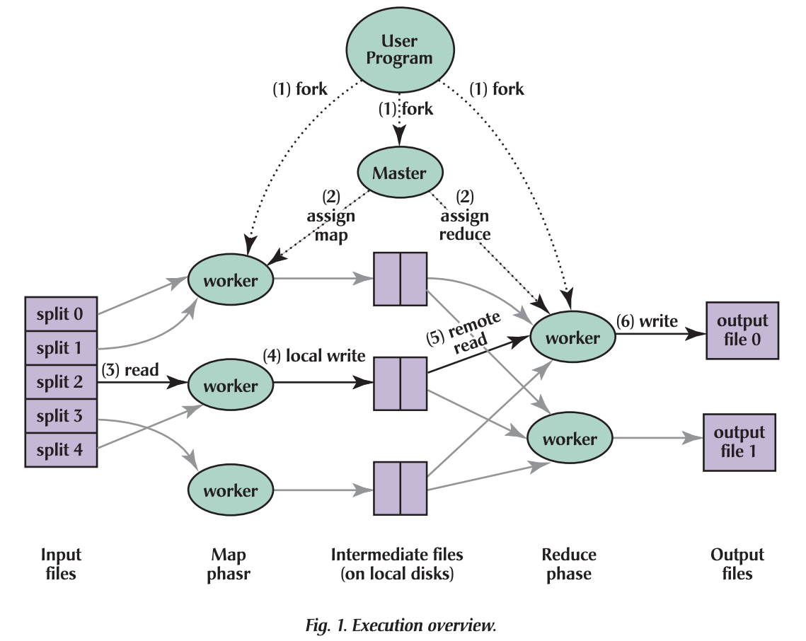






map and reduce workers can be in the same or different nodes
The Master is responsible for assigning the map and reduce roles to nodes
Copy
intermediate
results to
reduce nodes
Produce
intermediate
results
One worker can be responsible for multiple input files
map
reduce
https://dl.acm.org/doi/pdf/10.1145/1327452.1327492

Slide 8

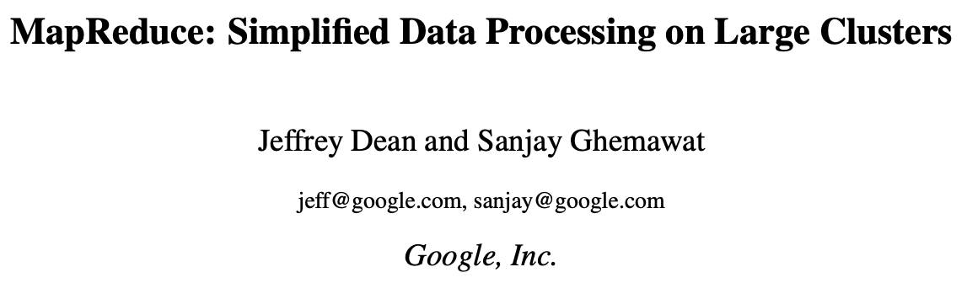
In summary
Performance trade-off: The higher the number of the computing nodes, the higher the computation speedup and the higher the data volume of the intermediate reports that need to be exchanged.
Suitability of MapReduce: highly parallelisable computing tasks that involve big datasets.
Examples: sorting, searching, indexing, classification
Do not use MapReduce when:
the dataset is small and can be processed by one computing node
you need to process data in real-time
you process data streams
the nodes need to communicate a lot with each other
For more details on the design of MapReduce, check the paper:
https://static.usenix.org/publications/library/proceedings/osdi04/tech/full_papers/dean/dean.pdf

